Slide 1
MONEY CHANGER MACHINE
A smart solution for currency exchange
Business planning presentation
Name :-Shivani Mali
College name:- Sangameshwar college solapur
Class:-Bsc-(ECS)-ll

Slide 2
Problem Identification
Difficuilty in getting exact change
Long queues in banks
Shops lack small denominations
Time –consuming exchange process

Slide 3
Proposed solution
ATM based money changer machine
24x7 availability
Fast and secure
Easy denomination selection

Slide 4
Working process
Start
Insert card
Enter PIN
PIN correct
No
Invalid PIN
yes
Enter amount
Print receipt
Select denomination
Sufficient cash?
No
Error :
Insufficient cash
End
Dispense notes

Slide 5
System Architecture
Card reader
Keypad & touch screen
Controller unit
Cash & coin dispenser
Bank server

Slide 6
Target market
Banks
Shopping Malls
Railway stations
Airports
Retailers

Slide 7
Business Model
Service charge per transaction
Installation fees
Maintainance contracts
Advertisements

Slide 8
Competitive Advantage
Faster service
24x7 operation
Less manpower
Secure transaction

Slide 9
Feasibility and Implementation
Uses existing ATM technology
Easy integration
Low operation cost
High demand

Slide 10
Social & economic Impact
Saves time
Reduce banks workload
Helps small businesses
Improves cash circulation

Slide 11
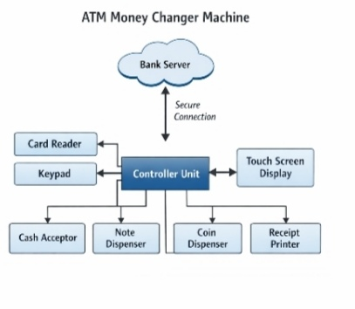
Machine structure

Slide 12
Conclusion
ATM money changer machine is a practical, profitable and future-ready business solution.

Slide 13
Thank you

